Slide 1

Welcome
Lab 2- Tools that Support your Online Business.

Slide 2
Lab 2
Expectations
Chat Support Available During Webinars
Knowing Your Resources
Webinar Process
Facebook Support
Search: Crexendo UP Website Competition
Online Resources
up.Crexendo.com/unr

Slide 3
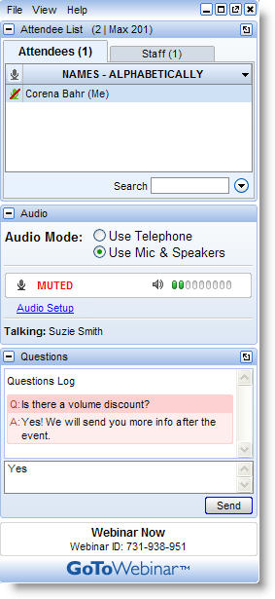
Lab 2
Live presentation
Attendees are muted
Type your questions in the “Questions” window
Questions answered live or via chat reply

Slide 4
Lab 2
Review
Finding a Dropshipper
Contacting Dropshippers
Processors
Shipping
Browser Compatibility
Use of add-on’s
Create a list of Possible Products Ideas
Select 1 of your Product Ideas
Take 5 min to think of keyword alternatives for that product
Using Google Keyword Tool
Q&A

Slide 5
Lab 2
Review
Finding a Dropshipper
Contacting Dropshippers
Processors
Shipping
Remove any keyword phrases that are not relevant and/or have a low GMS
Calculating Page Rank Average
Copy & Paste the final list of keyword phrases into the Keyword Research Document
Using Google Chrome search for product
Repeat process until you have the average page rank for all Keyword Phrases
Business License
Q&A

Slide 6
Lab 2
Review
Finding a Dropshipper
Contacting Dropshippers
Processors
Shipping
Pros and Cons of a Dropshipper
  Inventory
  Shipping
  Returns
Finding a dropshipper
  Google
  www.dailytrader.com
Q&A

Slide 7
Lab 2
Review
Finding a Dropshipper
Contacting Dropshippers
Processors
Shipping
Email Template available
Dropshipper Comparison Tool
Following up
Expectations
Selection
Q&A
Notes:
Show email template for contacting dropshippers
Discuss the Dropshipper comparison sheet.

Slide 8
Lab 2
Review
Finding a Dropshipper
Contacting Dropshippers
Processors
Shipping
What are Payment Processors?
PayPal vs. Merchant Accounts
Linking to Builder
  Processors
  Price Sets Payment Methods
Q&A

Slide 9
Lab 2
Review
Finding a Dropshipper
Contacting Dropshippers
Processors
Shipping
UPS Integration
Other options
Introduction to Ordering Rules
Q&A

Slide 10

Lab 2
Review
Finding a Dropshipper
Contacting Dropshippers
Processors
Shipping
Questions
Answers
Q&A

